Slide 1
Timers and counters in 8051

Slide 2
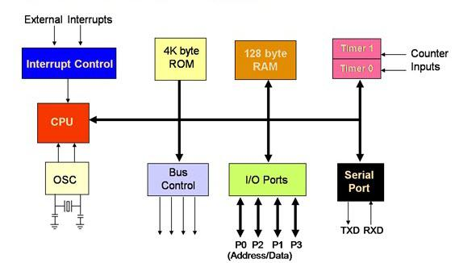
8051 ARCHITECTURE

Slide 3
In 8051…
The 8051 has two counters/timers which can be used either as timer to generate a time delay or as counter to count events happening outside the microcontroller.
The 8051 has two timers: timer0 and timer1.
Mostly internal clock- timer
External clock-counter
Configured by TMOD register
Both timers are 16 bits wide
Each 16-bit is accessed as two separate registers of low byte and high byte.

Slide 4
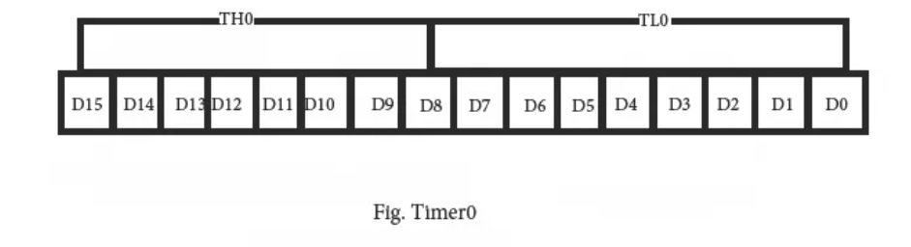
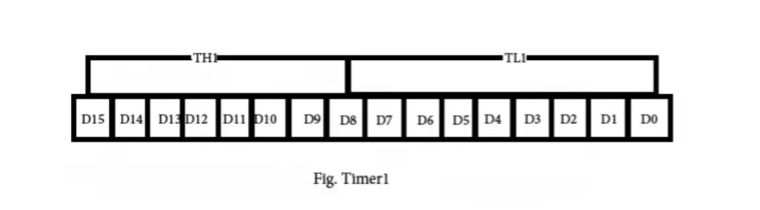

Slide 5
Loading counter
The timer is set as up counter.
Every clock it will increment by 1.
When it reaches FFFF H it will roll back to 0000 H, generating Timer overflow interrupt.(+1)
Count = FFFF-value +1
To count 8:
Count = FFFF-8+1= FFF8 H
IF TIMER 0 then TH0-FF H
TL0-F8 H
CODE:
MOV TH0, #FFH
MOV TL0, #F8H

Slide 6
Working of counter/timer
Counter is loaded in T0 or T1
For every clock it rolls by 1 bit, means counts by 1 bit.
Once FFFF is reached, Timer overflow interrupt bit is set to 1(TF0/TF1)
Now PC→INTERUPT SERVICE ROUTINE addresses the interrupt and gives RETI(return Interrupt).

Slide 7
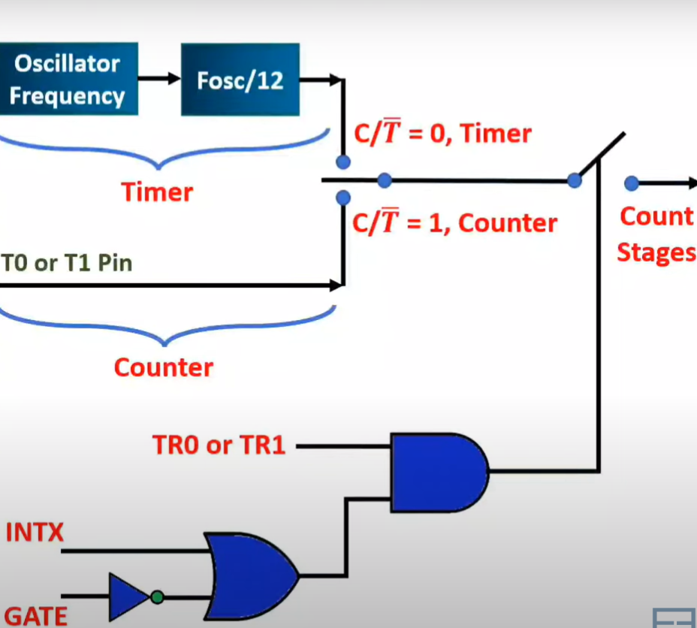
Working principle

Slide 8
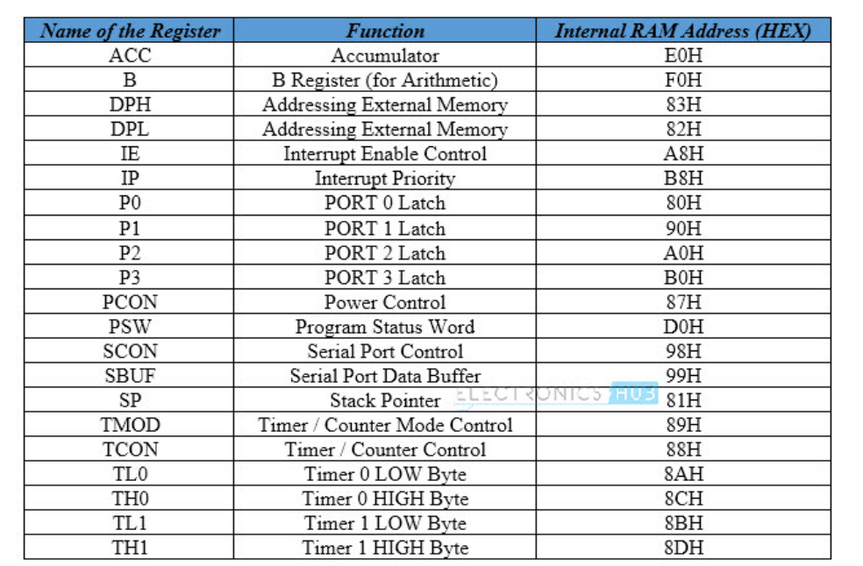

Slide 9
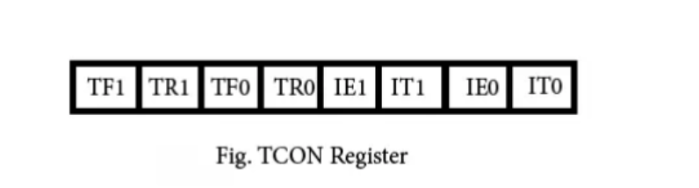
TCON Register
BIT Symbol Functions
7 TF1 Timer1 over flow flag. Set when timer rolls from all 1s to 0. Cleared
When the processor vectors to execute interrupt service routine
Located at program address 001Bh/ 000Bh
6 TR1 Timer 1 run control bit. Set to 1 by programmer to enable timer to
count; Cleared to 0 by program to halt timer.
5 TF0 Timer 0 over flow flag. Same as TF1.
4 TR0 Timer 0 run control bit. Same as TR1.
3 IE1 External interrupt 1 Edge flag. INT1/INT0
2 IT1 External interrupt1 signal type control bit. Set to 1 by program to
Enable external interrupt 1 to be triggered by a falling edge signal. Set
To 0 by program to enable a low level signal on external interrupt1 to
generate an interrupt.
1 IE0 External interrupt 0 Edge flag. INT1/INT0
0 IT0 External interrupt 0 signal type control bit. Same as IT0.

Slide 10
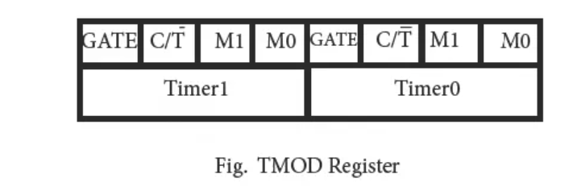
TMOD Register
C/T’→ Counter/ Timer
Gate → enable control-external/internal interrupts
M0 M1 Mode Operating Mode
0 0 0 13-bit timer mode, 8-bit timer/counter THx and TLx as 5-bit prescalar.
0 1 1 16-bit timer mode, 16-bit timer/counters THx and TLx are cascaded; There are no prescalar.
1 0 2 8-bit auto reload mode, 8-bit auto reload timer/counter; THx holds a value which is to be reloaded into TLx each time it overflows.
1 1 3 Spilt timer mode.

Slide 11
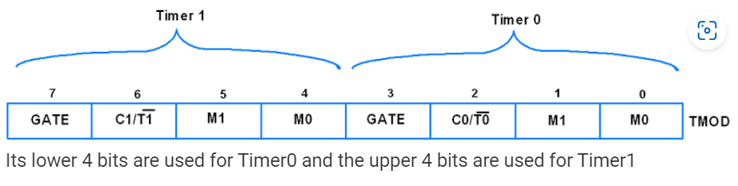
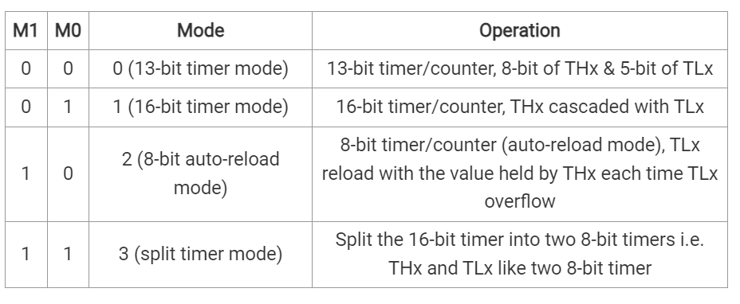

Slide 12
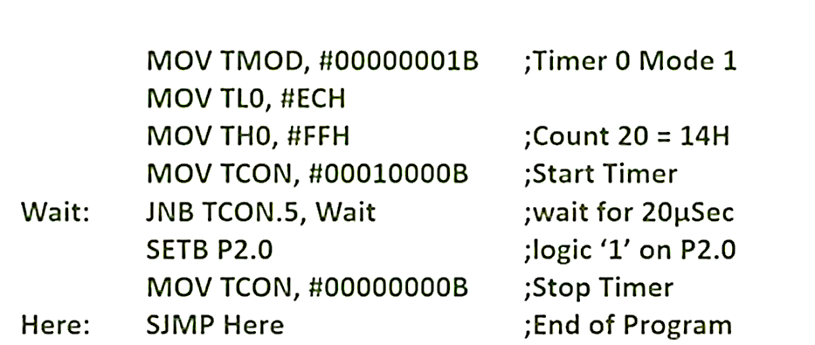

PROBLEM 1
Write a program to generate a delay of 20 µsec and send logic 1 on P2.0. Assume Fosc= 12MHZ

Slide 13
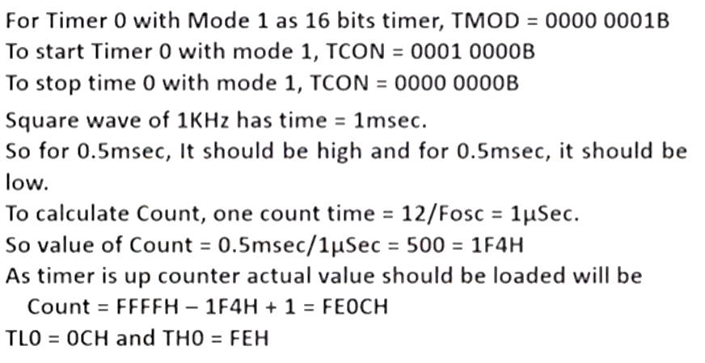
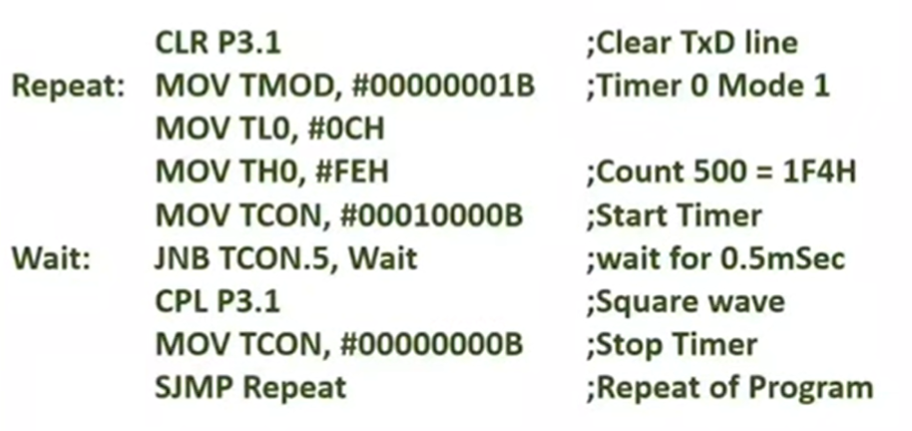
Problem 2
Write a program to generate a square wave of 1 KHZ on TXD pin, Assume Fosc= 12MHZ

